Slide 1


DR. BR Ambedkar National Institute of Technology
“ASSESSMENT OF PM 2.5 LEVELS IN PUNJAB AND DELHI NCR: A COMPARATIVE STUDY”
Minor Project
Presented By : Kavya Gupta (21112038)
Palak Gupta (21112058)
Presented To : Dr. Shailendra Bajpai

Slide 2
ABSTRACT
Particulate Matter 2.5 (PM2.5) pollution poses a significant threat to public health and the environment globally. This research provides review of the current understanding of PM2.5 pollution, its sources, distribution, and impacts in some cities like Punjab and NCR in India. Further study analyses its connection with stubble burning. It also evaluates that why PM 2.5 is more in winters than monsoon or summers. It also suggests ways for lowering PM 2.5 levels.

Slide 3
OVERVIEW
Introduction
Data for past years
Ways for lowering
Problem
Interpretation
Conclusion
Stubble Burning
Temporal/ spatial Variation
Causes
Safe Limits
Thank You

Slide 4
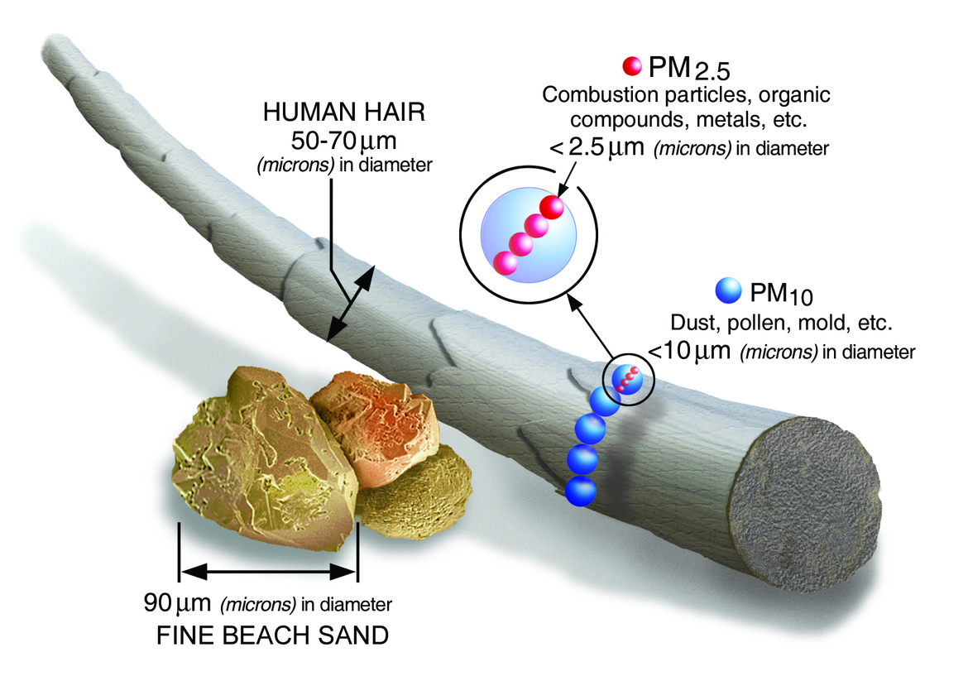
INTRODUCTION
PM2.5, which are airborne particles defined as having a diameter of 2.5 micrometers or less, are a varied combination of liquid and solid particles dispersed in the environment. Even while PM2.5 is frequently undetectable to the naked eye, it causes serious hazards to ecosystems, human health, and the global climate system.

Slide 5
PROBLEM
First Problem
Currently, atmospheric pollution has emerged as a primary global environmental pollution problem. Atmospheric particulate matter (PM) is a major contributor to air pollution and PM 2.5 is hazardous to even biological health.
These tiny droplets can penetrate deep into the lungs and even enter the bloodstream, causing a range of health issues including respiratory problems, cardiovascular diseases, and premature death.
Second Problem
Key challenges include accurately monitoring PM2.5 levels, identifying and mitigating sources of pollution, implementing effective policies to reduce emissions, and ensuring equitable access to clean air for all communities.

Slide 6
STUBBLE BURNING
1
Every winter, in the bustling city of Delhi and its neighbouring areas, a thick layer of smog settles and the air there is heavy with pollution - the consequence of a widespread agricultural practice known as stubble burning.
2
Stubble burning, the practice of setting fire to crop residues after harvesting, allowing farmers to prepare their land for the next sowing season without investing in costly machinery or labour is a widespread practice in agricultural regions of India, particularly in the northern states of Punjab, Haryana, and Uttar Pradesh.
3
The smoke, laden with particulate matter and noxious gases, wafts into the atmosphere having a significant impact on residents of Delhi, Punjab and Haryana.

Slide 7
STUBBLE BURNING
4
When this agricultural waste is burned, it releases a significant amount of pollutants, including PM2.5, into the air. These fine particles can remain suspended for long periods and can travel long distances, affecting air quality not only in the local area but also in neighboring regions and even countries.
5
Many studies have tried to understand the influence of parali or stubble on PM 2.5. One of the studies concluded that As the number of fire count increases or decreases in Punjab and Haryana, there is a corresponding increase or decrease in the particulate matter concentration with a time lag of few days (1 to 2 days).
6
One of the study estimated that stubble burning contributes 50–75% increment in PM2.5 in October and November.

Slide 8
STUBBLE BURNING
7
In one of the research an intensive field campaign involving the states of Punjab, Haryana and Delhi NCR was conducted from September 1 to November 30 in 2022 using 29 Compact and Useful PM2.5 Instruments with Gas sensors (CUPI-Gs).
8
PM2.5 in the region increased gradually from less than 60 µg m-3 from 6–10 October to up to 500 µg m-3 on 5–9 November, which subsequently decreased to about 100 µg m-3 from 20–30 November. The Indian national air quality standard for PM2.5 are 40 and 60 µg m-3 for annual and 24-hour exposure, respectively.
9
The measurements show PM2.5 values in the Punjab to Delhi NCR remained over 60 µg m-3 from mid-October to the end of November and crossed over 200 µg m-3 for the first two weeks of November at many sites.

Slide 9
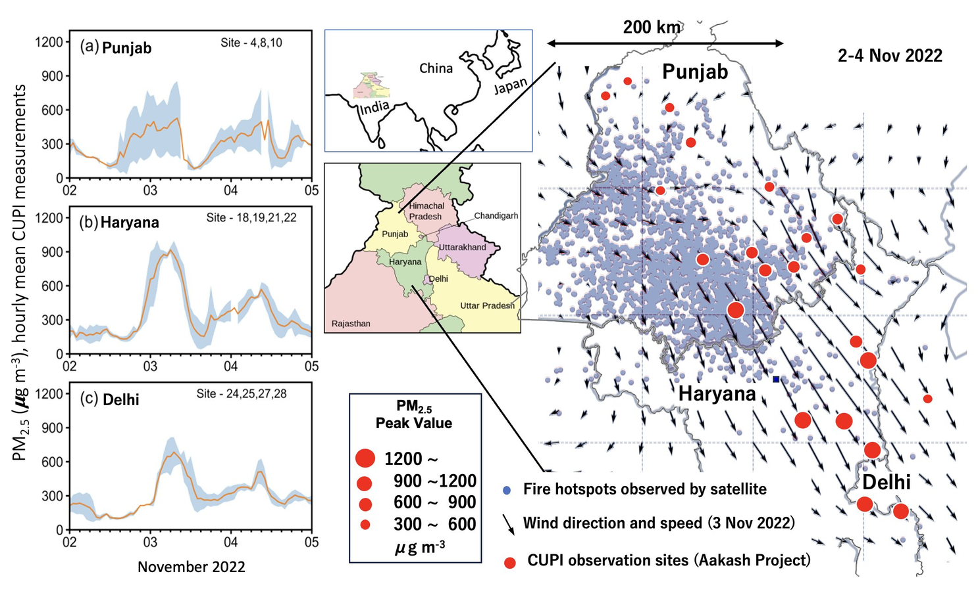
PM 2.5 levels in Punjab, Haryana and Delhi
after stubble burning

Slide 10
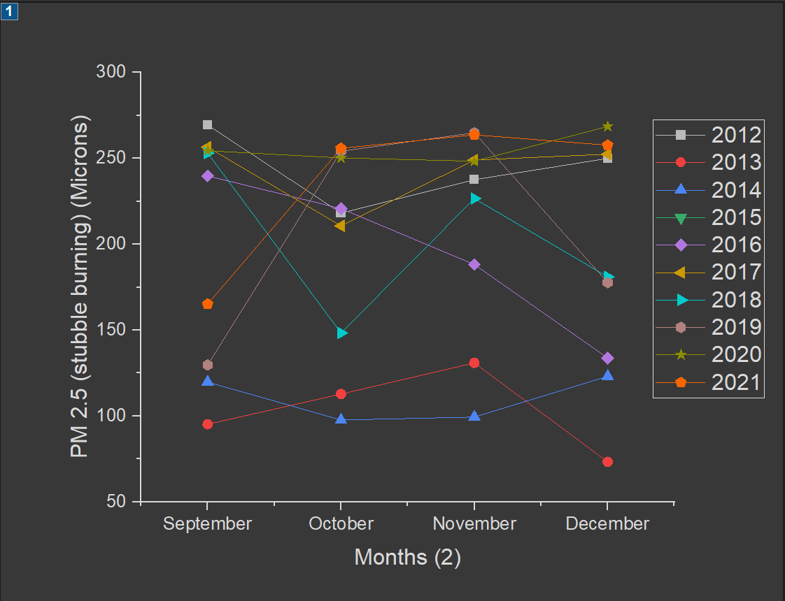
Data for Stubble burning
2012-2021

Slide 11
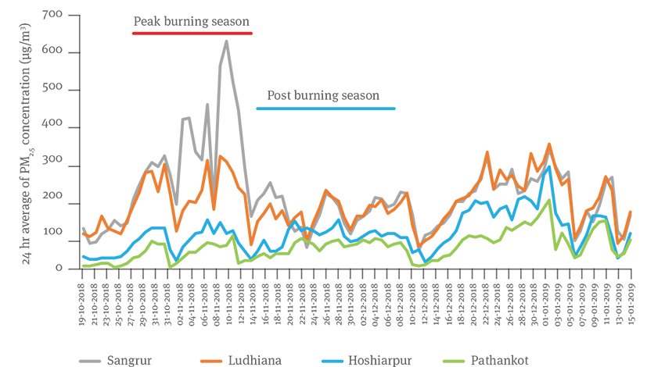
Data for PM 2.5 levels in Punjab in 2018 for burning of Crop Residue

Slide 12
CAUSES OF PM 2.5
Combustion Processes
Vehicle Emissions - Exhaust from Trucks, cars, buses and other vehicles emit PM 2.5 as a by product of burning of fossil fuels like gasoline and diesel. Emissions from vehicles, especially diesel-powered ones, contribute significantly to PM2.5 pollution.
Industrial Processes- Manufacturing facilities, power plants, and other industrial activities that involve combustion release PM2.5 into the atmosphere.

Slide 13
CAUSES OF PM 2.5
Residential cooking - Burning wood, coal, oil and other fuels for heating and cooking in residential settings can produce PM2.5.
Agricultural activities
Stubble Burning - Burning of crop residue releases significant amounts of particulate matter, including PM2.5, into the atmosphere. These fine particles can remain suspended for long periods and are easily transported over long distances, contributing to air pollution.

Slide 14
CAUSES OF PM 2.5
Construction
Activities such as construction, demolition, and road paving can generate PM2.5 from dust and debris. Clearing of land for the establishment of structures, the excavation and compaction of the construction site, and the movement of construction equipment and heavy machinery contributes to emission of PM 2.5

Slide 15
CAUSES OF PM 2.5
Transportation
Marine vessels burning heavy fuel oil emit PM2.5, especially in port areas and along shipping routes. Aircraft engines produce PM2.5 as they burn aviation fuel. All vehicles produces PM 2.5 as they burn fuel.
Natural Sources
Forest fires and wildfires produce large amounts of PM2.5 as organic material burns. Natural sources are contributed by sea salt aerosols, volcanoes, wildfires, dust storms, living vegetation, and biological aerosol particles

Slide 16
CAUSES OF PM 2.5
Biomass Burning and Residential Activities:
Burning of biomass (wood, crop residues, and other organic materials) for cooking and heating is common in rural areas.
Residential activities contribute to PM2.5 pollution, especially during colder months.
Efficient and cleaner cooking technologies can help reduce emissions.
Weather Conditions:
Stagnant meteorological conditions (such as low wind speeds and temperature inversions) trap pollutants close to the ground.
These conditions exacerbate PM2.5 levels, especially during winter when dispersion is limited.

Slide 17
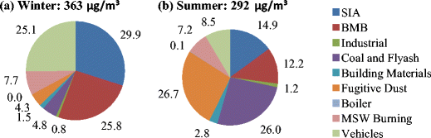
Source apportionment of PM2.5 in Delhi during winter and summer

Slide 18
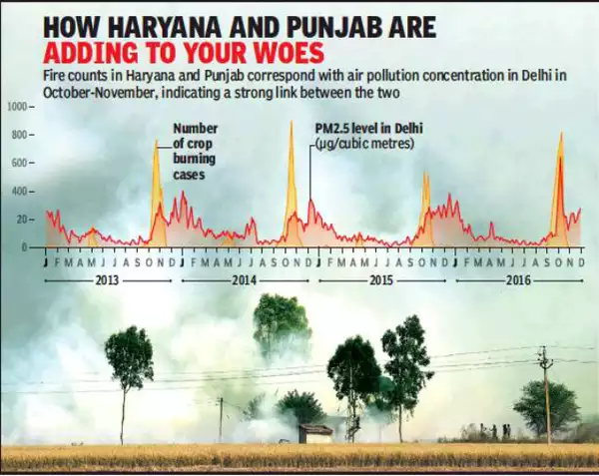
ROOT CAUSE OF PM 2.5
The root causes of PM2.5 pollution in Punjab and Delhi are complex and multifaceted, influenced by a combination of natural and anthropogenic factors. Crop residue burning (CRB), occurring immediately after the paddy harvest in the post-monsoon (September–November), is a common practice in Punjab, Haryana and part of Indo-Gangetic Plain (IGP)

Slide 19
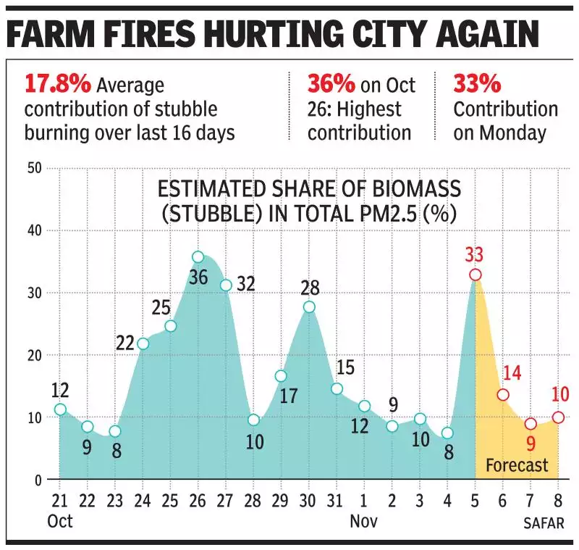
ROOT CAUSE OF PM 2.5
Other causes are excessive emissions from power plants, vehicles, manufactures, and domestic heating released into the atmosphere.
Due to extensive biomass burning in Punjab, northwestern Delhi, PM2.5 concentrations in the post-monsoon season have reached as high as 200 μg m−3.

Slide 20
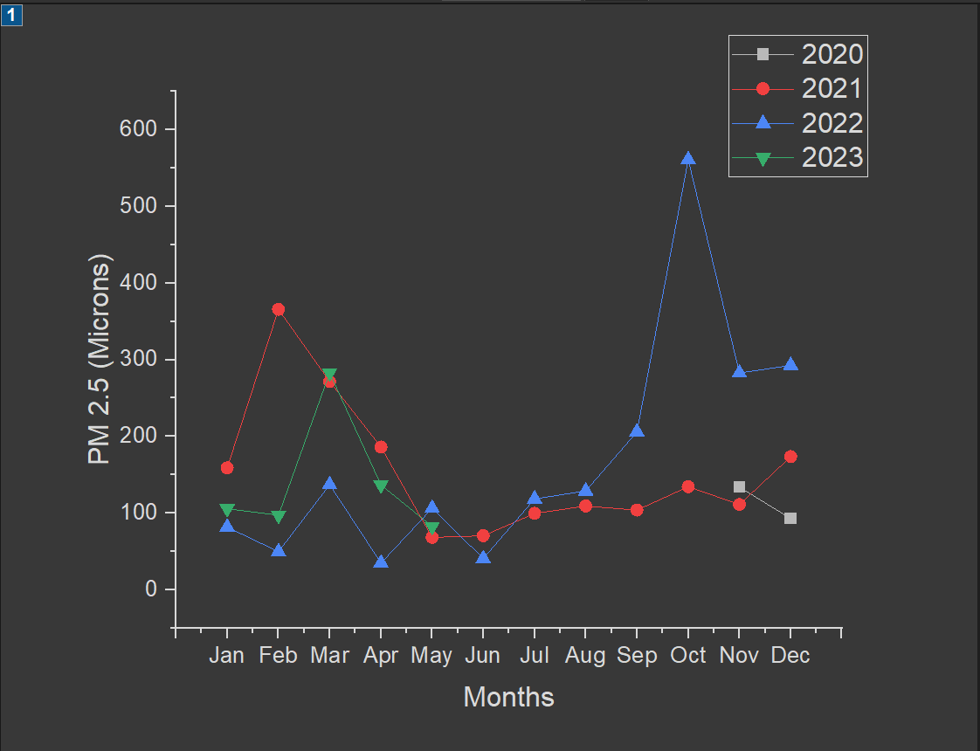
Data for past years
Delhi

Slide 21
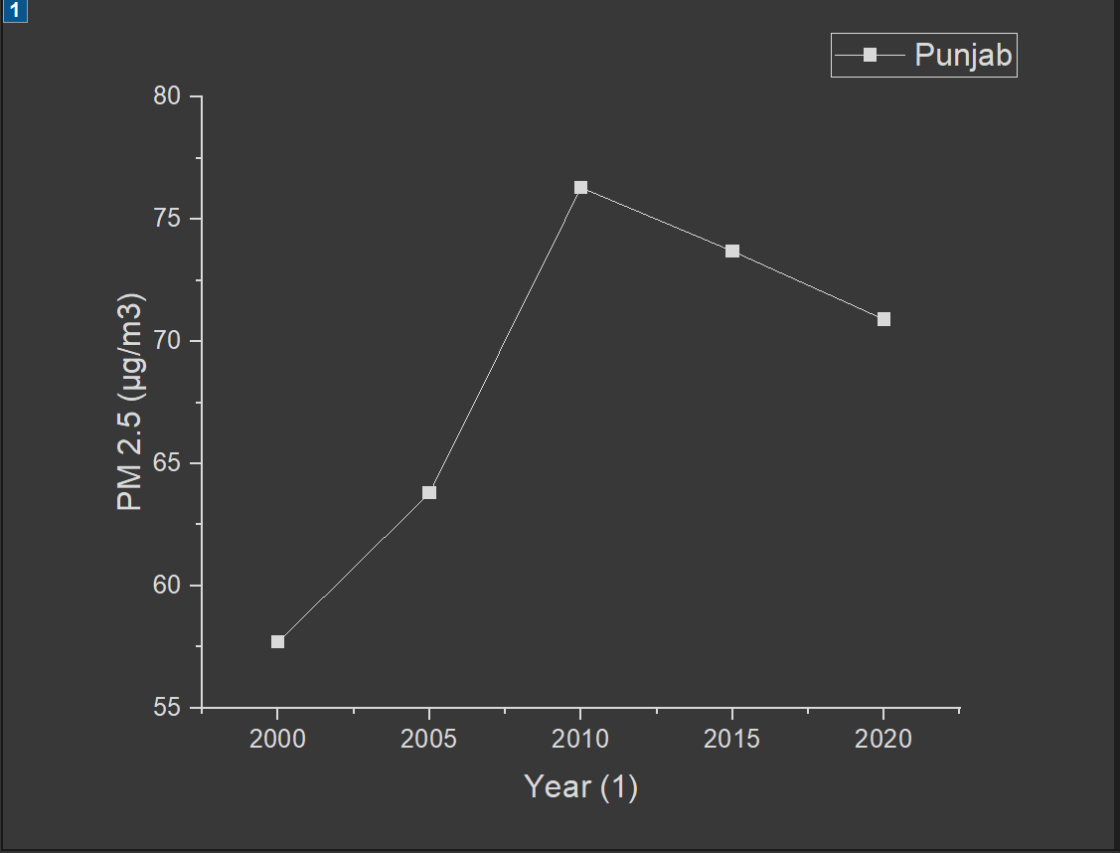
Data for past years

Slide 22
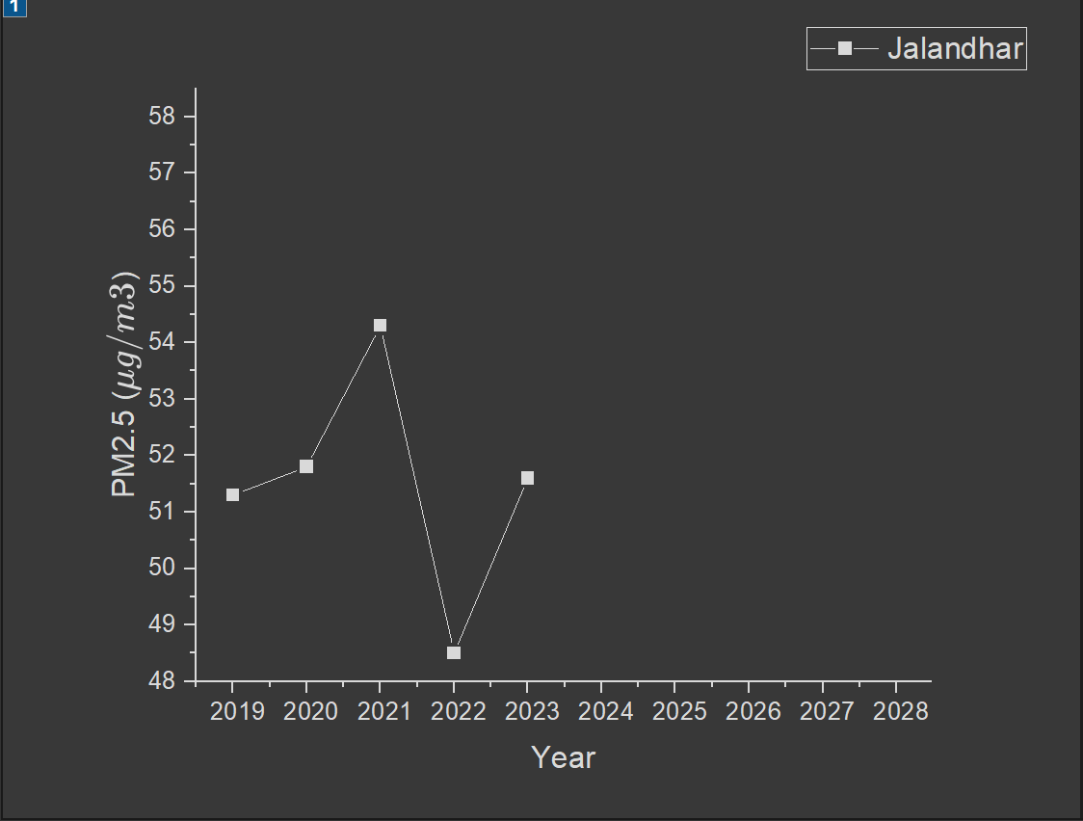
Data for past years

Slide 23
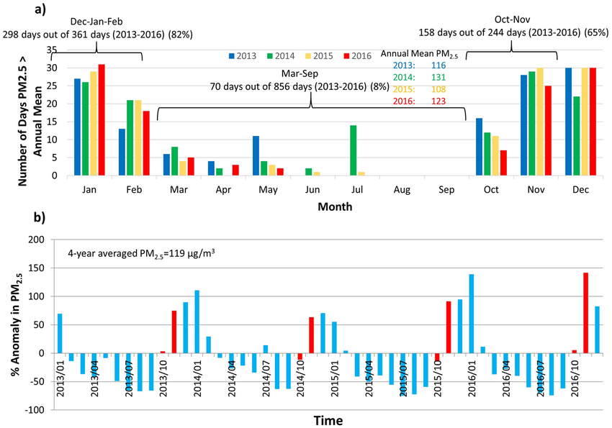

Slide 24
INTERPRETATION
Crop Residue Burning:
Other Sources:
During the post-monsoon season (which includes winter), crop residue burning is a common practice in many parts of India.
Crop residue burning releases large amounts of pollutants into the air, including PM2.5.
The increased PM2.5 levels during winter are partly attributed to this agricultural activity.
These include vehicular emissions, industrial activities, and residential heating (e.g., burning wood or coal for warmth).
The combination of increased emissions and unfavorable meteorological conditions exacerbates PM2.5 pollution during winter
Meteorological Factors:
Local Factors:
Temperature and Relative Humidity play a significant role in PM2.5 concentration.
In the monsoon season, humidity is higher, which can help in settling down particulate matter. As a result, PM2.5 levels are lower.
During winter, lower humidity and cooler temperatures allow PM2.5 particles to remain suspended in the air for longer periods, leading to higher concentrations.
The specific geography and local patterns of pollution also influence PM2.5 levels.
For example, different zones within a state may experience varying pollution levels due to factors like industrial zones, traffic density, and land use patterns

Slide 25
TEMPORAL/SPATIAL VARIATION
Temporal Variation:
Annual Averages:
Over the past 15 years, the average PM2.5 concentration in Punjab has been 125 ± 86 µg/m³ (ranging from 20 to 985 µg/m³).
Recent Trends:
In 2023, Punjab experienced a 1.5 times increase in PM2.5 concentration compared to the recommended limit set by the World Health Organization (WHO)
The current PM2.5 concentration in Punjab is 32 µg/m³, which is 1.3 times above the WHO-recommended limit2.
Various cities in Punjab exhibit different PM2.5 levels:
Abohar: PM2.5 level is 16 µg/m³.
Amritsar: PM2.5 level is 34 µg/m³.
Jalandhar: PM2.5 level is 34 µg/m³.
Ludhiana: PM2.5 level is 20 µg/m³.
Patiala: PM2.5 level is 23 µg/m³1.
Air Quality Forecast:
The forecast indicates varying PM2.5 levels over the next few days, with temperatures ranging from 22°C to 31°C1.

Slide 26
SPATIAL VARIATION
PM2.5 levels vary across different cities within Punjab due to factors like traffic density, industrial zones, and local emissions.
Urban areas near major traffic corridors may have higher PM2.5 concentrations.
Efforts to improve air quality should consider targeted interventions based on local patterns.

Slide 27
TEMPORAL VARIATION
FOR DELHI
Annual Averages:
Over the past 15 years, the average PM2.5 concentration in Delhi has been 125 ± 86 µg/m³ (ranging from 20 to 985 µg/m³).
Seasonal variations are evident:
Winter: Average PM2.5 concentration during winter is 174 ± 75 µg/m³.
Summer: Average PM2.5 concentration during summer is 101 ± 48 µg/m³.
Monsoon: Average PM2.5 concentration during the monsoon season is 66 ± 50 µg/m³.
Post-Monsoon: Average PM2.5 concentration during the post-monsoon season is 192 ± 93 µg/m³1.
Recent Trends:
In 2023, Delhi experienced a 2% increase in PM2.5 concentration compared to 2022, breaking the trend of improvement observed since 2015-1723.
Real-Time Data (as of April 30, 2024):
The current PM2.5 concentration in New Delhi is 85 µg/m³, which is 2.9 times above the WHO-recommended limit4.
Various locations in Delhi-NCR exhibit different PM2.5 levels, ranging from 38 µg/m³ to 62 µg/m³4. For instance:
Anand Lok: PM2.5 level is 62 µg/m³.
Greater Kailash II: PM2.5 level is 58 µg/m³.
Green Park: PM2.5 level is 51 µg/m³.
Hauz Khas: PM2.5 level is 47 µg/m³.
Lajpat Nagar: PM2.5 level is 59 µg/m³.
Malviya Nagar: PM2.5 level is 45 µg/m³.
Mayur Vihar: PM2.5 level is 43 µg/m³.
Model Town: PM2.5 level is 31 µg/m³.
Mukherjee Nagar: PM2.5 level is 24 µg/m³4.

Slide 28
SPATIAL VARIATION
PM2.5 levels vary across different localities within Delhi-NCR due to factors like traffic density, industrial zones, and land use patterns.
Areas near industrial zones or major traffic corridors tend to have higher PM2.5 concentrations.
Residential areas may also experience elevated PM2.5 levels due to vehicular emissions and other sources.
Larana University | 2024

Slide 29
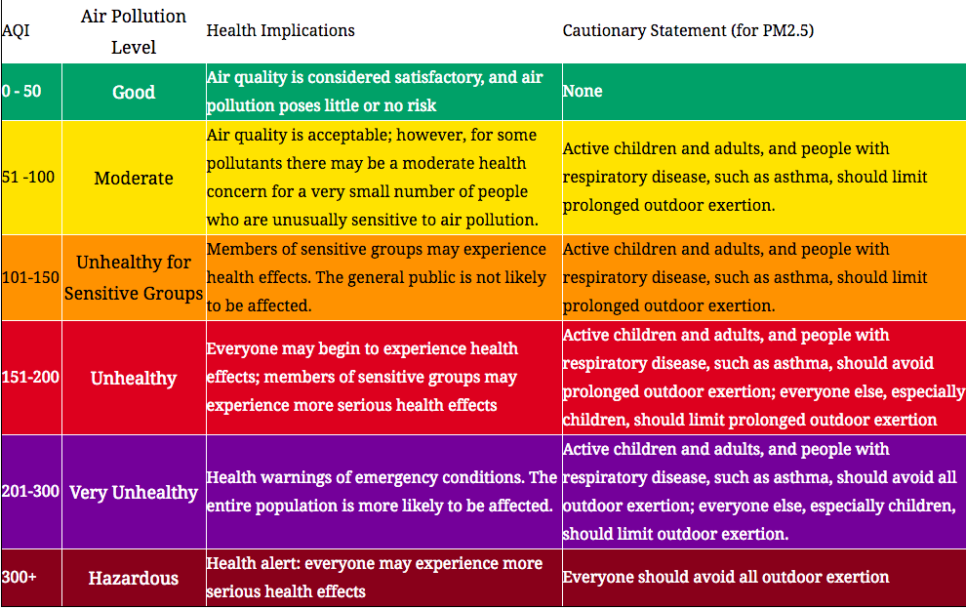
Safe limits for PM 2.5

Slide 30
WAYS FOR LOWERING PM 2.5 LEVELS
Industry
Construction Sites
Implement stricter emission controls for industries. Encourage cleaner technologies and energy sources.
Enforce guidelines to minimize dust emissions from construction activities.
Road Dust
Waste Management
Focus on dust control measures, including regular road cleaning, green cover, and pavement management.
Improve waste collection, segregation, and disposal to reduce open burning and landfill emissions1.

Slide 31
WAYS FOR LOWERING PM 2.5 LEVELS
Clean Fuels
Education
Promote the use of clean fuels (e.g., natural gas) in industrial processes.
Raise awareness about air quality, pollution sources, and individual responsibilities.
Electricity Supply
Ensure reliable electricity supply to reduce dependence on diesel generators and backup power sources.

Slide 32
TRANSPORTATION MEASURES
Traffic Emission Reduction
Odd-Even Rule
Encourage public transport, cycling, and walking. Implement vehicle emission standards and promote electric vehicles.
Consider implementing traffic rationing measures like the odd-even rule (although its impact may be limited).
Regional Emissions
Address emissions not only within Delhi but also in other regions to achieve better results.

Slide 33
PUBLIC AWARENESS AND COMPLIANCE
Compliance Complaints
Behavioral Changes
Act on complaints received through pollution control boards’ online portals. Address construction and municipal solid waste (MSW) burning issues based on these complaints.
Encourage citizens to adopt cleaner practices (e.g., avoiding open burning, proper waste disposal) and reduce personal emissions like smoking, transportation etc
Education
Raise awareness about air quality, pollution sources, and individual responsibilities.

Slide 34
POLICY IMPLEMENTATION
National Clean Air Programme (NCAP)
Local Governance
Strengthen local governance and coordination among agencies responsible for air quality management.
Allocate funds and implement sector-specific action plans to achieve air quality targets in NCR states.

Slide 35
CONCLUSION
The study highlights the urgent need for comprehensive air quality management strategies in both Delhi and Punjab. While Delhi needs to focus on reducing emissions from vehicles and industrial activities, Punjab must address the issue of agricultural burning. Collaborative efforts, involving government policies, technological innovations, and public awareness, are essential to mitigate PM 2.5 pollution and protect public health in these regions. Long-term solutions require sustained commitment and cooperation between regional authorities, central government, and the community to achieve cleaner air and healthier living conditions.

Slide 36
REFERENCES
https://www.researchgate.net/figure/Source-apportionment-of-PM25-in-Delhi-during-a-winter-and-b-summer_fig2_319887463
https://www.researchgate.net/figure/Chemical-composition-and-source-apportionment-of-PM25-in-a-Delhi-during-winter-and_fig1_319887463
https://timesofindia.indiatimes.com/city/chandigarh/punjabs-three-cities-figure-among-20-most-polluted-cities-across-the-nation-in-air-quality-in-2023/articleshow/106707218.cms#:~:text=Jalandhar%20recorded%20PM%202.5%20levels,challenges%20in%20improving%20air%20quality
https://www.sciencedirect.com/science/article/abs/pii/S0045653523004484
https://www.ndtv.com/india-news/improvement-in-delhis-annual-pm2-5-levels-since-2015-17-halted-in-2023-says-cse-report-4799751
https://www.aqi.in/dashboard/india/punjab
https://pubs.rsc.org/en/content/articlehtml/2022/ea/d2ea00027j
https://link.springer.com/article/10.1007/s11356-021-17431-4
https://www.statista.com/statistics/1051325/india-pm-25-levels-in-delhi/

Slide 37
Thank You

